Slide 1

Narasaraopet Engineering College (autonomous)
Thyroid Disease Prediction
Under the estimated guidance of
Y.CHANDANA MTech.
Assistant professor
Team members
I. Sowkya (19471A0525)
Ch. Mounika (19471A0509)
D.NehaSree (19471A0517)

Slide 2
CONTENTS
Abstract
Literature Survey
Requirements
Implementation of Code
Conclusion

Slide 3
ABSTRACT
In medical field, the salient and demanding task is to diagnose patient’s health conditions and to provide proper care and treatment of the disease at the initial stage.
Classification based Machine learning plays a major role in various medical services. Let us consider Thyroid disease as the example.
The main goal is to recognize the disease at the early stages with a very high correctness.
Thyroid disease diagnosis is not a simple task. It involves many procedures. The normal traditional way includes a proper medical examination and many blood samples for blood tests.
So we use different types of machine learning algorithms and predict the result . For example : classification Predictive Modelling, Decision Tree ID3.

Slide 4
Literature Survey
Prediction of disease at early stages is very important , mainly in case of thyroid. Some recent studies from Mumbai have suggested that congenital hypothyroidism is common in India.
Most cases of congenital hypothyroidism happen because the thyroid doesn't form correctly in the baby during pregnancy.
Congenital hypothyroidism can lead to serious complications if not detected in early stages. Therefore, the proposed model serves the goal in early detection of thyroid disease.
A proper train dataset results into an accurate predicting model therefore reducing the overall cost of the thyroid patient treatment and also saving the time .
Classification algorithms are most suitable in decision making and also solving the real world problems.

Slide 5
The Thyroid is butterfly-shaped endocrine gland which is situated at the base of the human neck.
The vital role of the thyroid gland is maintaining and balancing human metabolism and also the growth and development of the human body.
Any damage or improper functioning of the gland may seriously affect the normal human body functioning .
If there is either low or high secretions of the hormone it will adversely affect the human health.
There are different types of thyroid hormones and their effects on body are different . They need to be detected to reduce its effect on body.

Slide 6
They have studied various classification based machine learning algorithms. They have considered train data set from UCI Machine Learning repository and compared and analyzed the performance metric of decision tree, support vector machine and K-nearest neighbor.
The main attributes we need to consider are Age , sex , on_thyroxine , query_on_thyroxine , pregnant.
They have considered Thyroid data preprocessing mainly by applying the decision tree algorithm. They have first calculated the mean values of T3, T4 and TSH and considered as the preprocessing stage.
Later on they have applied machine learning based feature selection and feature construction. Further they have applied classification based J48 algorithm which is a continuation of ID3 algorithm and calculated the results.

Slide 7
For a classification model to be developed, it requires a good train dataset using which the model can learn the behavior and predict possible outcomes with higher accuracy.
The four main tasks in Classification Predictive Modeling are, Binary Classification, Multi-Class Classification , Multi-Labeled Classification Imbalanced Classification .
A Binary Classification refers to a classification which has only two class tags.
Multi-Class Classification have more than two class tags. This type of classification is very useful when the classifiers are more in number.
The Binary Classification Algorithms can also be applied in Multi-Class Classification.
Multi-Labeled Classification includes two or more class tags wherein one or more class tags.
Imbalanced Classification refers to such classification sets wherein the number of the examples classes are not equally distributed.

Slide 8
SOFTWARE AND HARDWARE REQUIREMENTS
Software requirements
Browser : Any Latest browser like Chrome
Operating System : Windows 10
Language :Python
Platform : Google COLAB
Hardware requirements
Processor : Intel(R) Core™2 i7-5500U CPU @ 2.50GHz
RAM : 8GB(gigabyte)
System Type : 64-bit operating system, x64-based processor

Slide 9
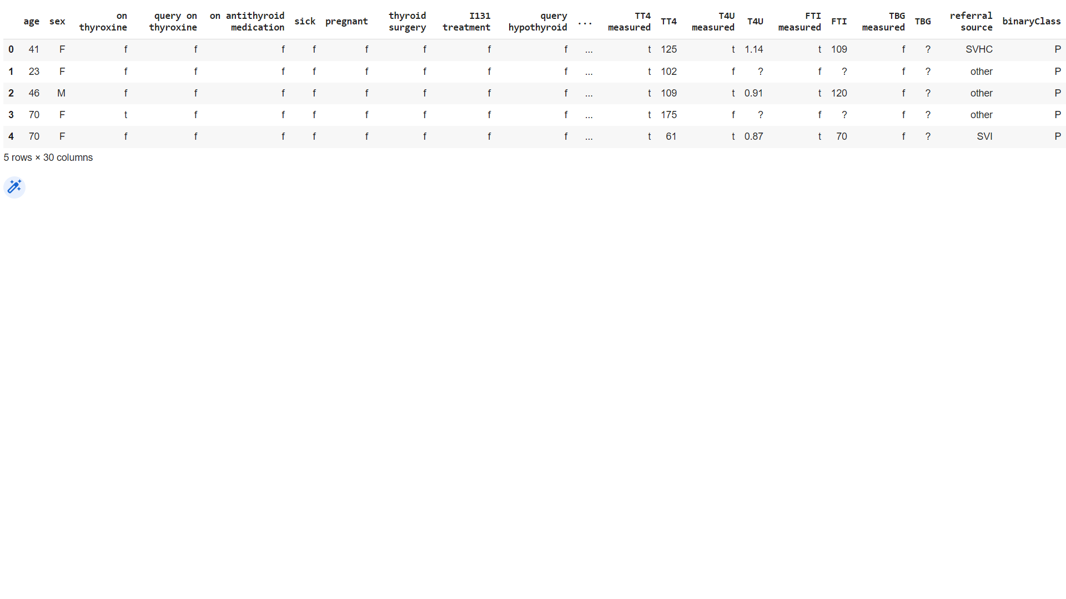
CODE :
thyroid_df = pd.read_csv(‘/content/sample_data/hypothyroid.csv')thyroid_df.head()

Slide 10
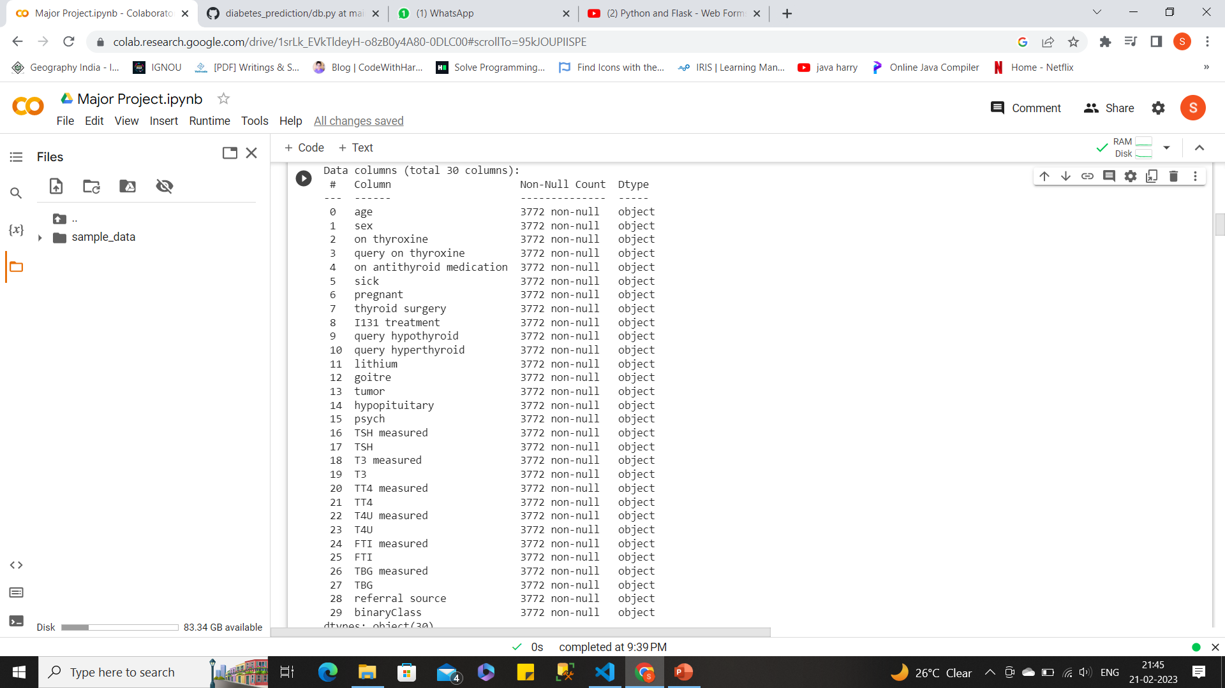
thyroid_df.info()

Slide 11
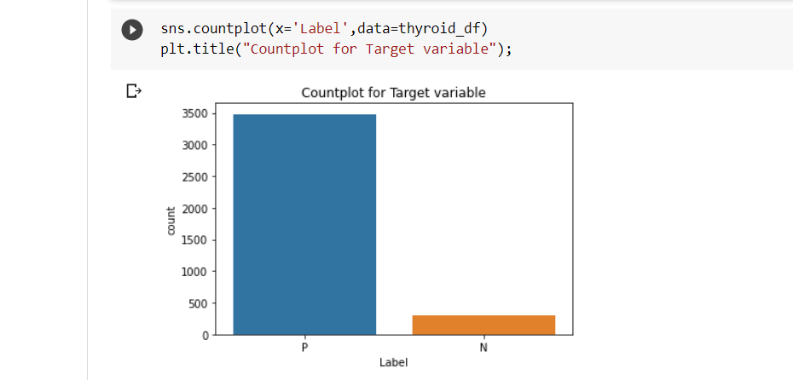

Slide 12
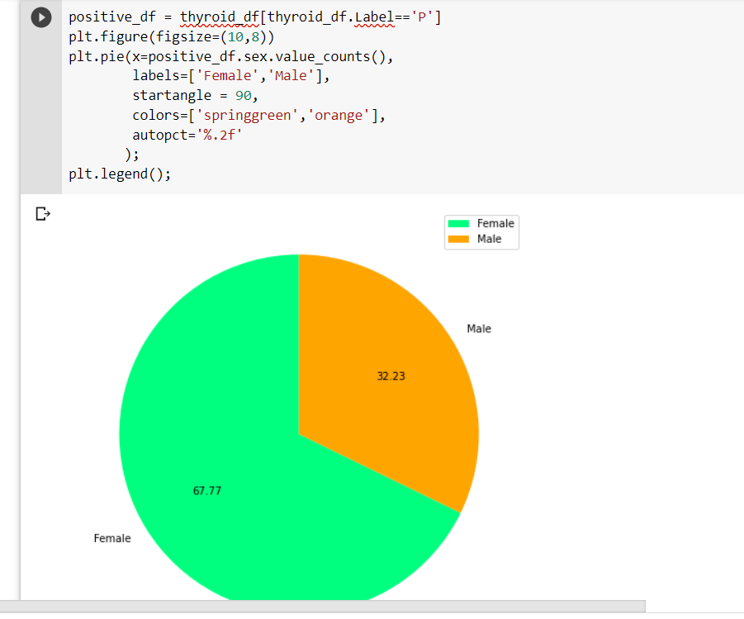

Slide 13
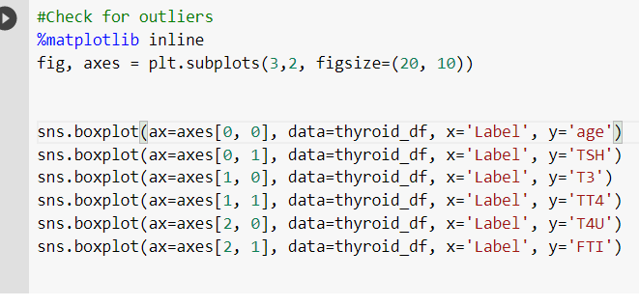
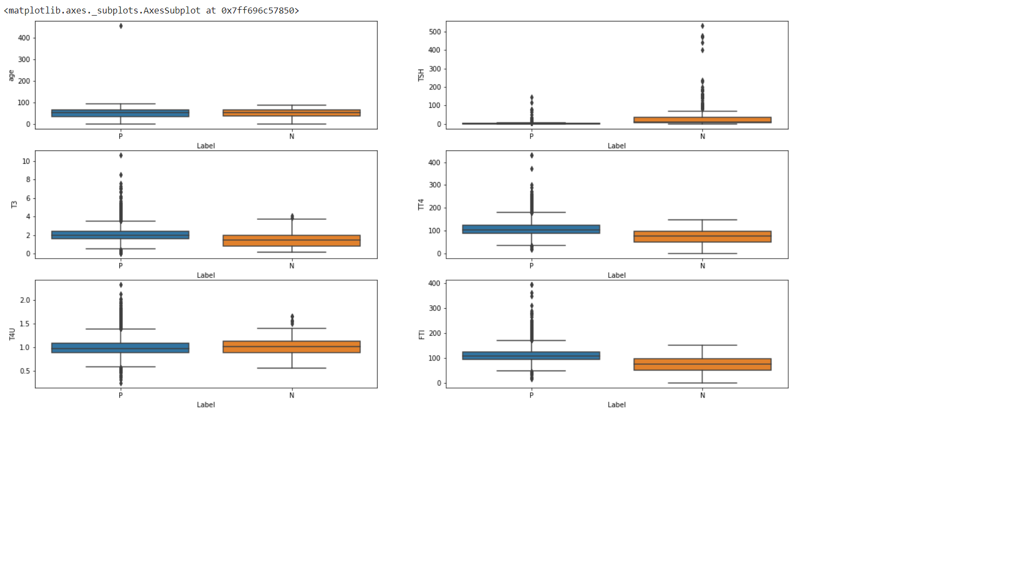

Slide 14
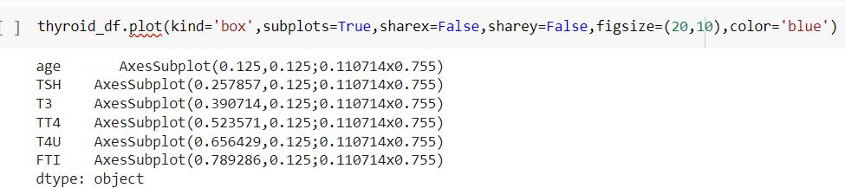
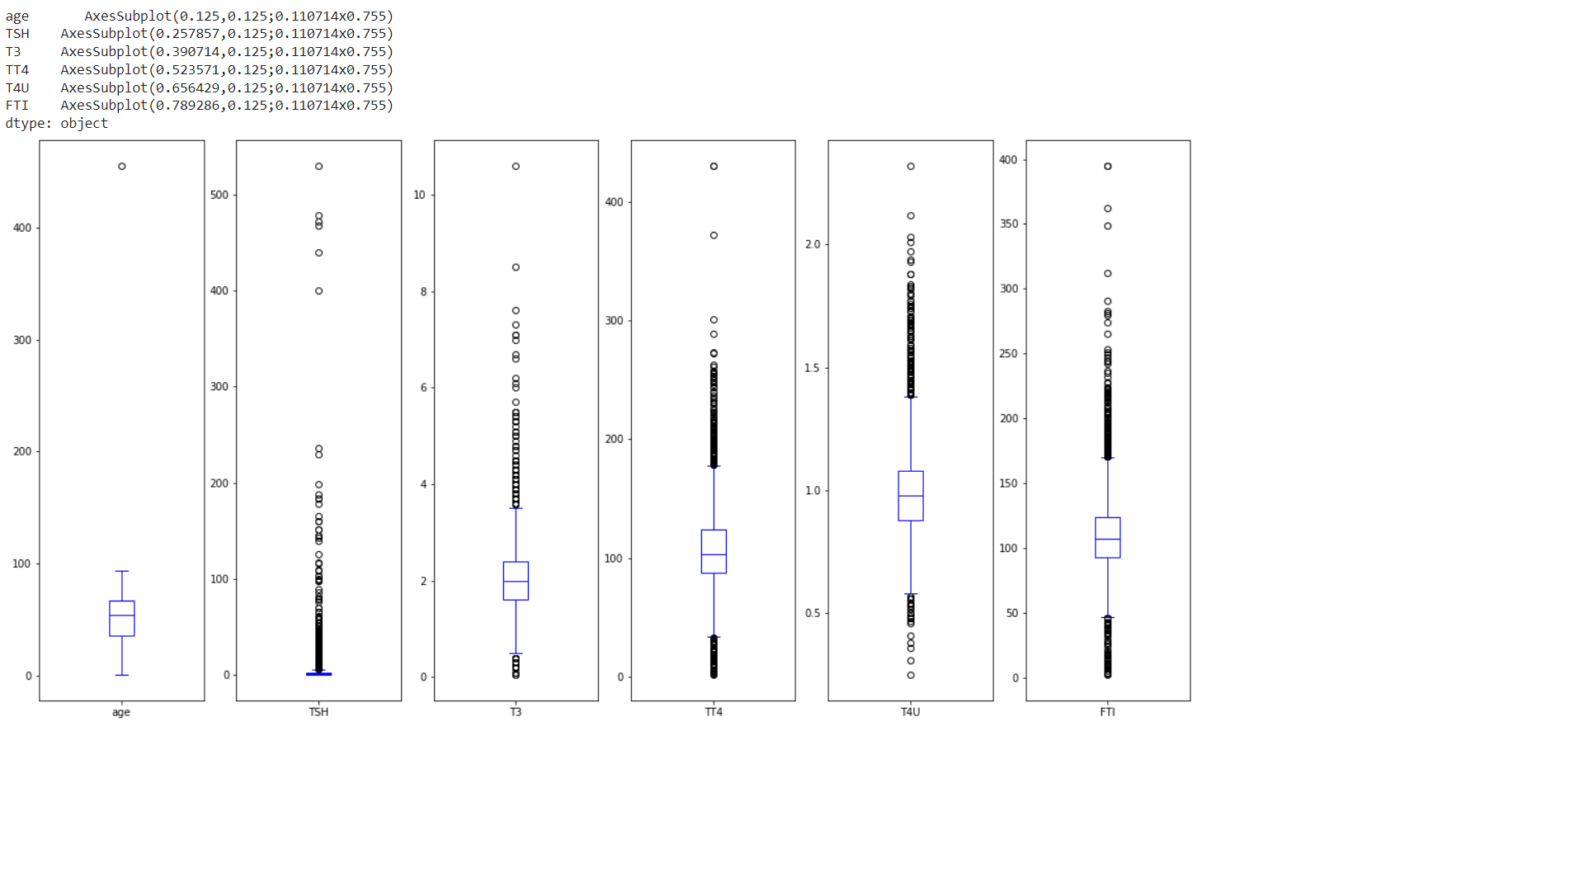

Slide 15
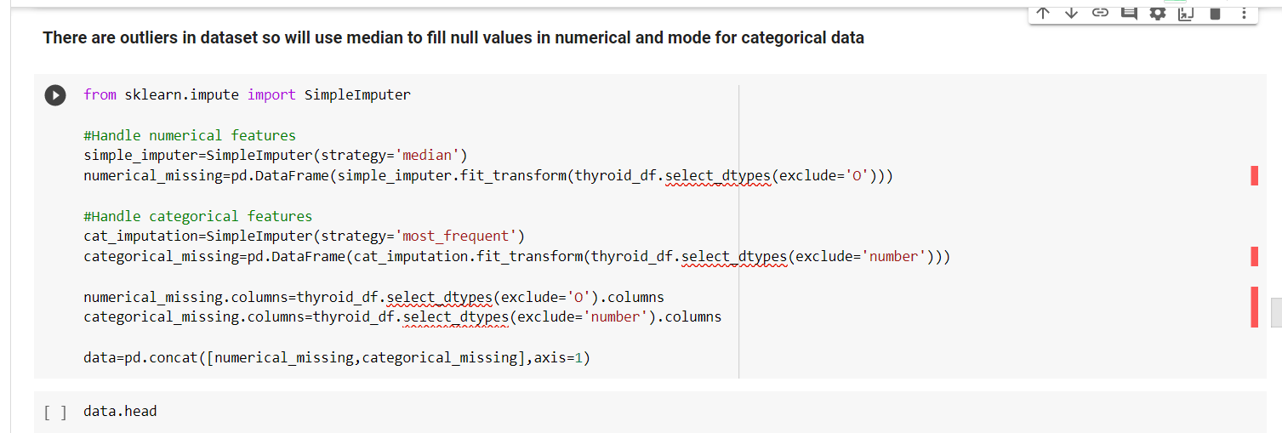
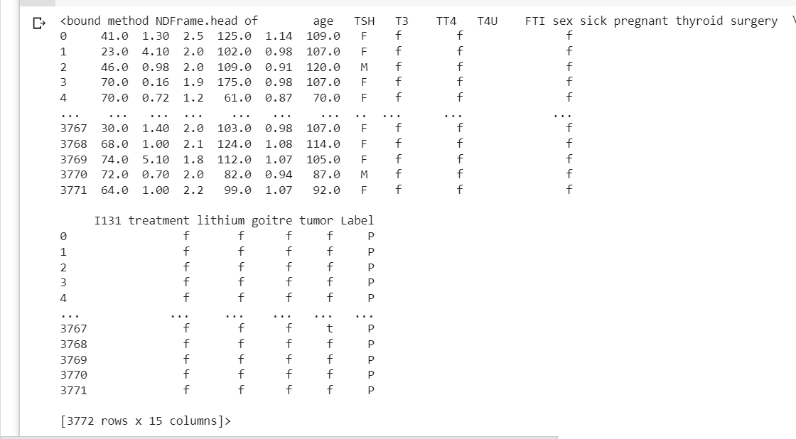

Slide 16
Conclusion
Thus the proposed work will be very much useful to identify the thyroid disease in a patient at an early stage using classification based machine learning techniques. These algorithms give various levels of precision and accuracy.

